Slide 1
Project Review Summative Evaluation : Final Date: 06/07/2023
Speech Recognition & Translation for Endangered Languages.
Basil K Raju
211109
Under the Guidance of
Dr Elizabeth Sherly
Kerala University of Digital Sciences Innovation and Technology
Thiruvananthapuram

Slide 2
Overview of the
Presentation
Introduction
About Malasar Language.
Objective
Challenges
Proposed System.
Corpus Creation
Transformer Based Model for ASR
Result and Discussion for ASR
Transformer Based Model for MT.
Result and Discussion for ASR
Conclusion
Contributions
Future and Scope
Acknowledgement

Slide 3
Introduction
Project aims to develop a Automatic Speech Recognition and Machine Translation for the Malasar Language.
Automatic Speech Recognition and Machine Translation plays a vital role in saving endangered languages.
Malasar is ultra low resource language. It's a Dravidian language consist of approximately 7000+ speakers.

Slide 4
About Malasar Language.
Attapady dialect of Irula [iru]
Walayar dialect of Irula
75%
75%
67%
-
72%
Lexical
similarity
Eravallan
[era]
Malayalam
[mal]
70%
65%
70%
Tamil [tam]
Muduga [udg]

Slide 5
Objective
Develop a Automatic Speech Recognition for Malasar.
Develop a Translation Model from Malasar to English.

Slide 6

Challenges
To develop a Deep Learning model for the Malasr ASR and Malasar MT requires a huge corpus.
No existing corpus is available.
Audio length should be less than 30s.
ASR Corpus
MT Corpus
Malasar Speech | Malasar Text
 | நீவியி மனசு
 | அதவு செஞ்சு காட்டுனீ
Malasar Text | English Text
அக்களு | Elder Sister
அடையி | Pack

Slide 7
Proposed System.
Malaser Speech
Parallel Malasar and English Corpus
Malasar
ASR
Malasar
MT
Corpus
Transformer Based
ASR
Transformer Based
MT
Corpus
Trained Malasar
ASR
Trained Malasar
MT
Text in Malasar
Translated in English Text

Slide 8
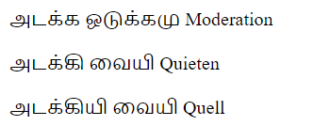
Corpus Creation
Wycliffe India provided the data, Wycliffe India is an interdenominational, non-sectarian and non-profit mission organization.
The speakers consist of males and females between the age of 30-35
Malasar Spoken Bible
Malasar Bible Text
English Bible Text
22 Chapters of Luke
5 Hours of Speech
Malasar Dictionary
Raw Data

Slide 9

Creating ASR Corpus
ASR Dataset-1
Total Duration | 5 Hours
Utterance | 965
Speakers | 1 Female , 1 Male (Age between 30 & 35)
Domain | 22 Chapters of Luke from Bible
Sample Rate | 16KHz
Audio Length | Maximum 30 seconds
Structure | [ : Malasar_Txt]
Sample Audio

Slide 10


Creating ASR Corpus
ASR Dataset-2 : Synthetic Voice
Total Duration | ~4.5 Hours
Utterance | 17,700
Domain | Malasar Dictionary Words
Sample Rate | 16KHz
Audio Length | ~1 seconds
Structure | [ : Malasar_Txt]
Sample Audios

Slide 11
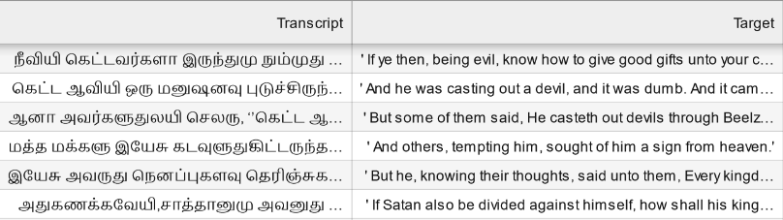
Creating MT Corpus
Utterance | 905
Domain | 22 Chapters of Luke from Bible
English Bible Version | KJV Version
Structure | [Malasar_Txt : Eng_Txt]

Slide 12
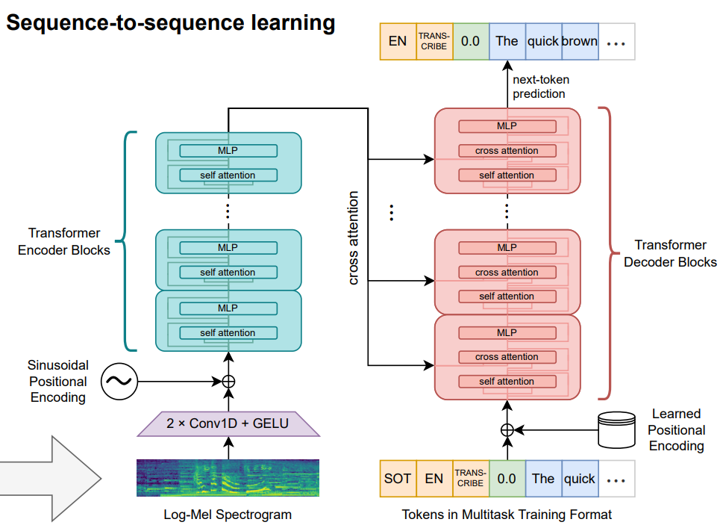
Architecture of Transformer Based ASR.

Slide 13
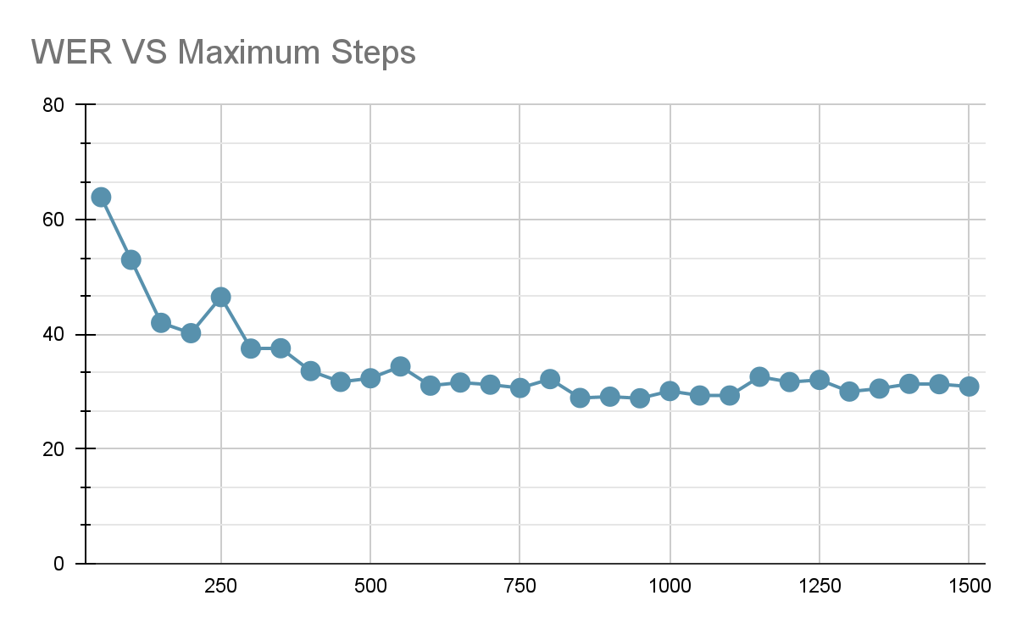
Result and Discussion : ASR
18 hours of training resulted in a WER of 28%.
When validated manually we got WER in between 15-20%.
We used Max_Step parameter for training and saved model at every 50th step.
The best model is finalised by manual validation.
WER
Maximum Steps

Slide 14
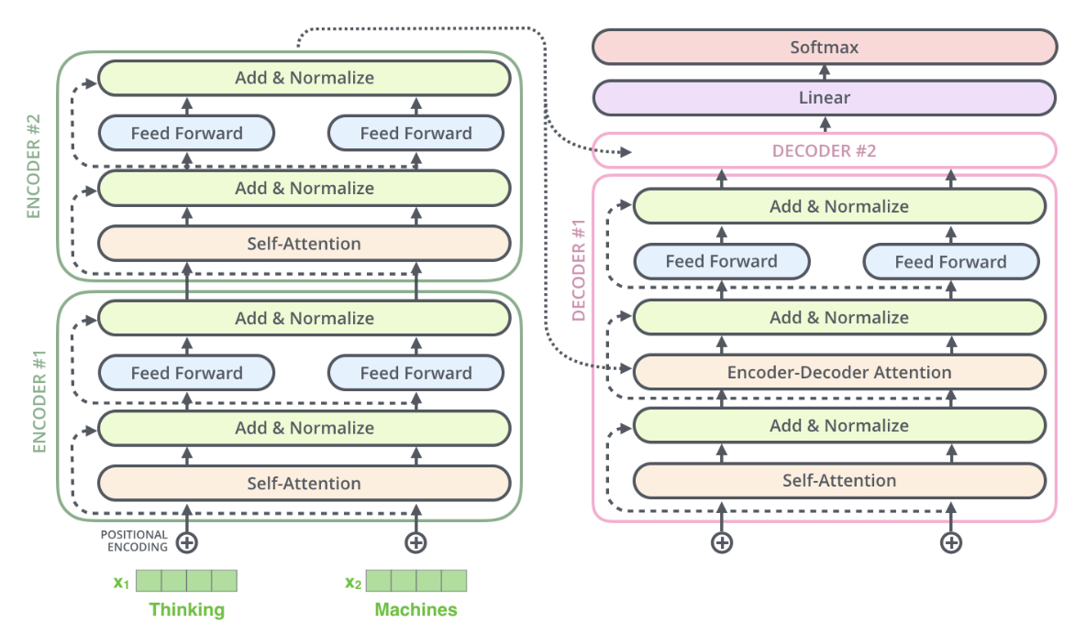
Architecture of Transformer Based MT Model.

Slide 15
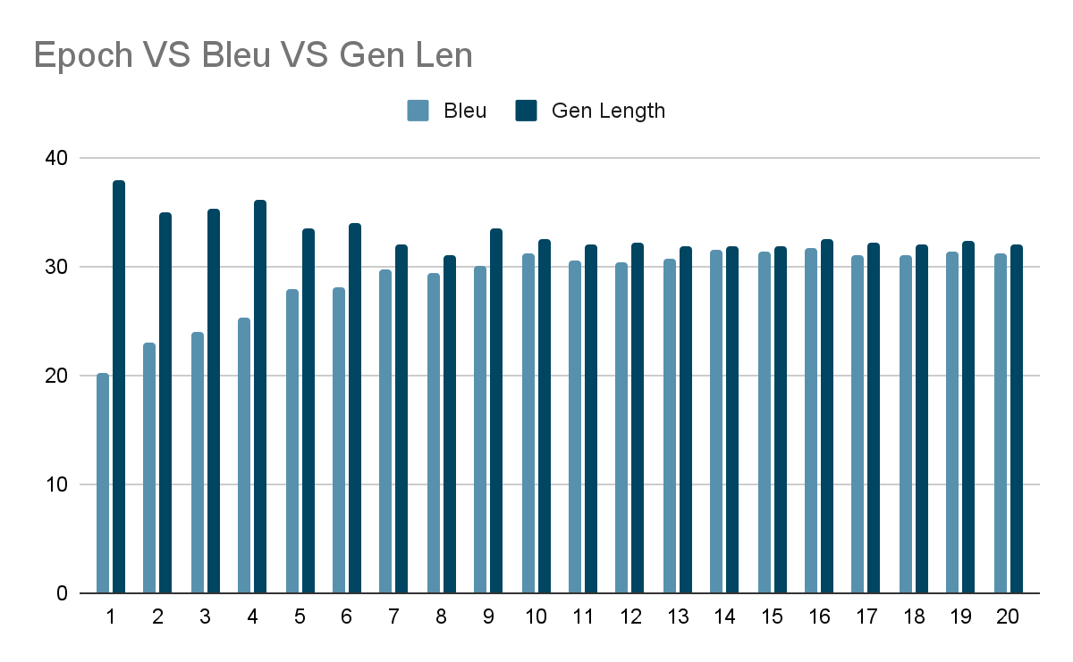
Result and Discussion : MT
The trained Transformer based machine translation models translates the Malasar to English with a BLEU score of 30.
When manually validated accuracy is low when compared to the system validation score.
Epoch

Slide 16
Contribution
Created Corpus which can be used for Automatic Speech Recognition, Machine Translation.
Developed ASR system for transcribing Malasar Language.
Developed Machine Translation system for translating Malasar Language to English.
Deployed the ASR model which can be accessed by anyone.

Slide 17
Conclusion
The project proposes the first Machine Learning based system for the preserving the Malsar Language by building ASR and MT models.
The model is able to generalise within small amount of corpus.
The Automatic Speech Recognition Model have WER in between 15-20% and the Machine Translation Model have BLEU score of 30.
The MT models needs to be improved.

Slide 18
Future Scope
Developing a Speech Translation system for the Malasar language.
Creating a large corpus will help to improve the accuracy of models.
Using single model for ASR and Translation at the same time.

Slide 19
Acknowledgement
First and foremost, I would like to express our deepest appreciation to Dr. Elizabeth Sherly from the Digital University of Kerala for her unwavering support and invaluable guidance throughout the project. Her expertise and insights were instrumental in shaping this work.
I am also immensely grateful to Kavya Manohar and Leena G for their dedicated guidance and assistance throughout the project. Their expertise, feedback, and encouragement were pivotal in my progress and overall success.
I would like to acknowledge Wycliff India for providing the essential data required for the development of our project. Their generous contribution and support enabled me to effectively tackle the challenges and achieve our goals.

Slide 20
Any Questions ?
Thank You

